Slide 1
Online Gaming research hub
CSE 212 : Database System Lab
Presented by : Shawan Das (20)
Twisha Saha Chaudhury (14)
Registration : 19101020
Number 19101014
Section : A₁

Slide 2
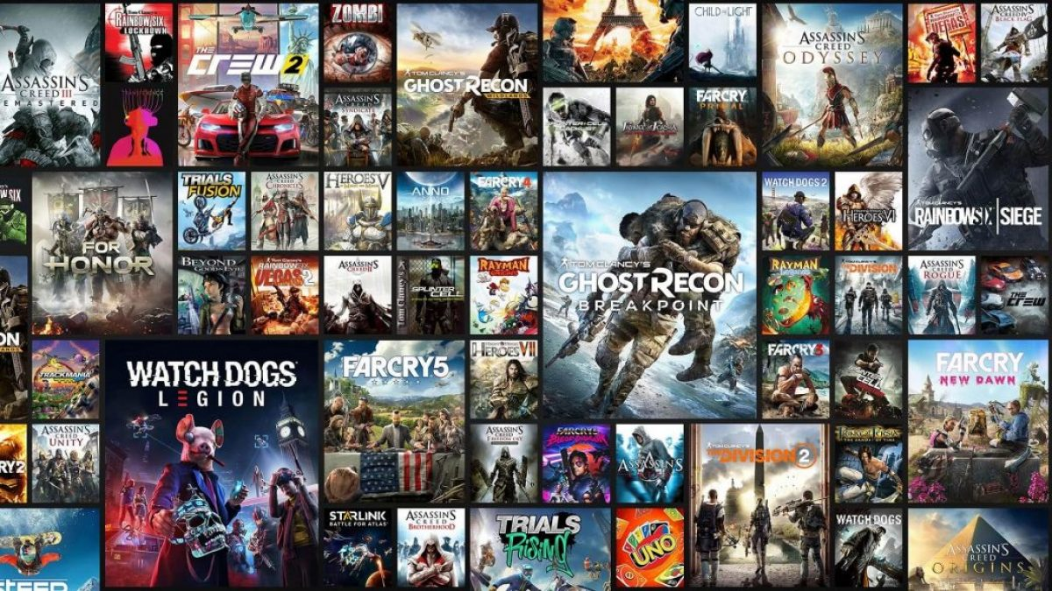
Overview
The purpose of this Database Management System is to help in online game surveys.
Researchers and Developers can collect information about previous games
Gamers overview in individuals games
Popularity of games
Popular game types

Slide 3
Features
Organized online game information
Reviews of individual game
Gamer’s information
Popularity of games
Game Developers and Publishers details

Slide 4
Database Model and Relations
Game (Contains data of the games)
Developers (Contains data of game developers)
Publishers (Contains data of game publishers)
Information(Relation between Game, Developers & Publishers)
Gamers(Contains Gamers profile information)
Play (Contains data of gamers)
Review (Contains data of game reviews)

Slide 5
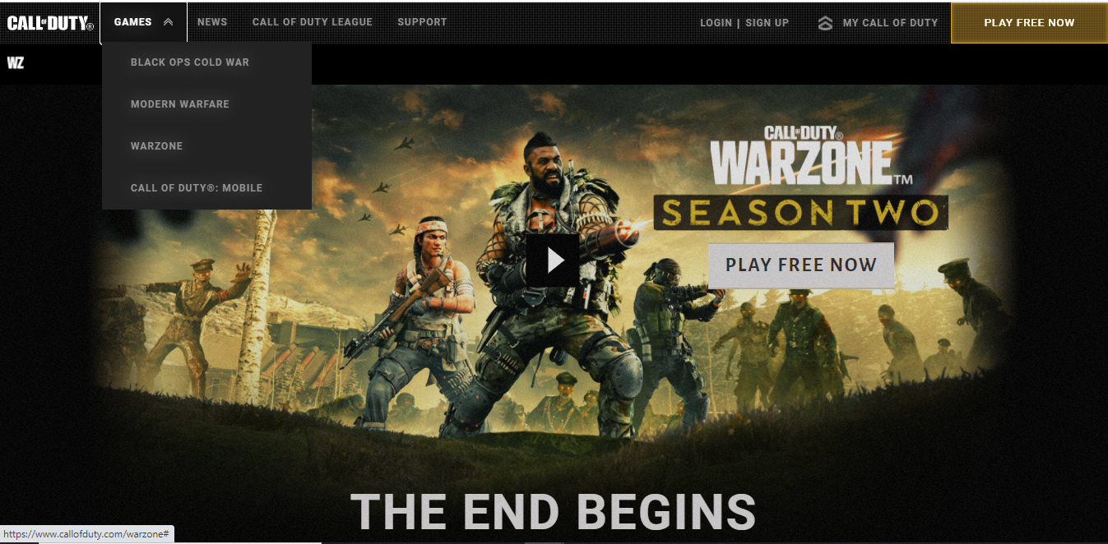
“Game” Relation
Game ID
Game Name
Genre
Release Year
Platform

Slide 6
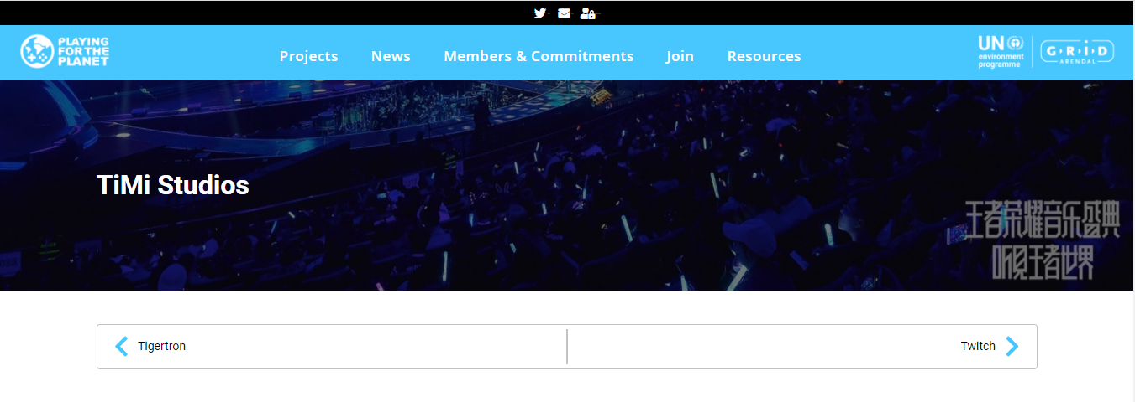
“Developers” Relation
Developer’s Name
Developer’s ID
Salary

Slide 7
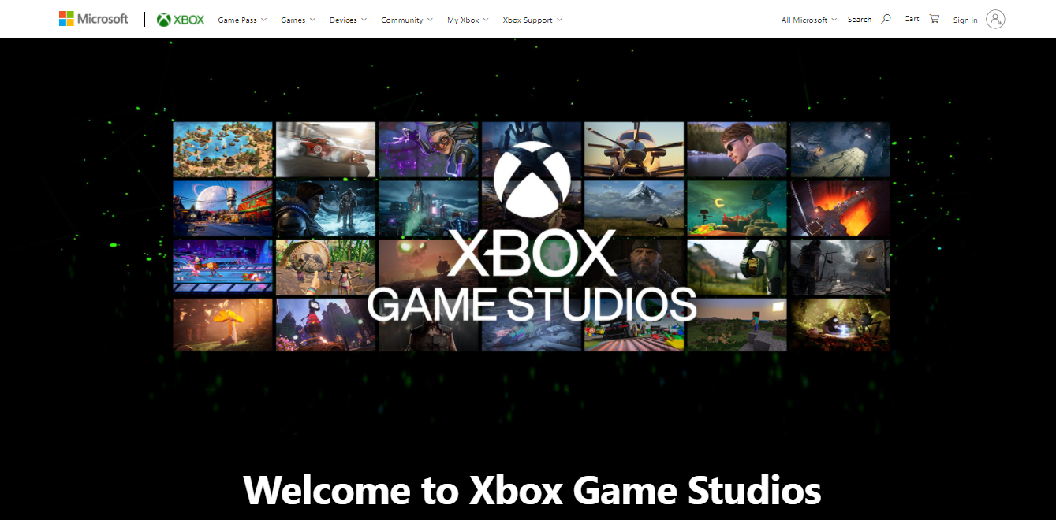
“Publishers” Relation
Publishers Name
Publishers ID
Profit

Slide 8
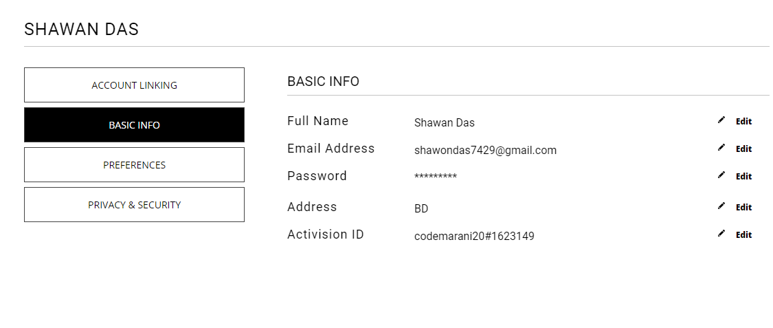
“Gamers” Relation
Gamer Name
Gamer ID
Email

Slide 9
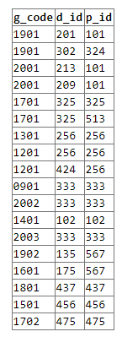
“Information” Relation
Game_ID
Developer_ID
Publisher_ID

Slide 10
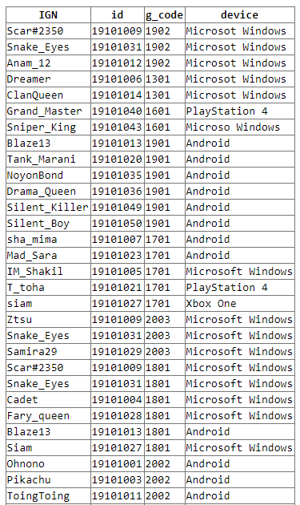
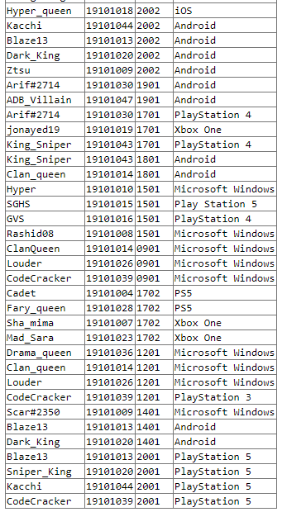
“Play” Relation
IGN(Game Name)
ID(Player_ID)
Game_Code
DEVICE
(players using device)

Slide 11
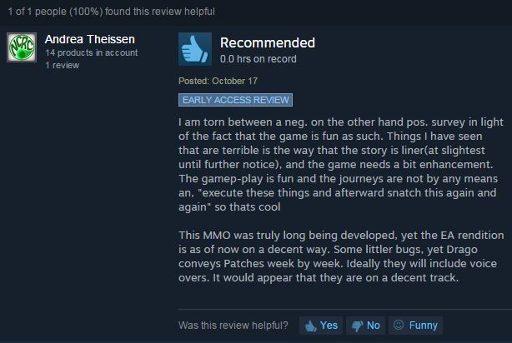
“Reviews” Relation
Game Code
Rating
Comments

Slide 12
E-R Diagram
Review Game
Review
G_Code Rating Comments
Games
Game Id Game Name Genre R_year Device Rating
AverageRating
Developer
Name ID Salary
Game Info
Develop
Game
Information
G_Code D_Id P_Id
Play Games
Gamers
Player Name Player ID Email
Publisher
Name ID Profit
Publish
Game
Play
IGN ID G_Code Device
Gamers Play

Slide 13
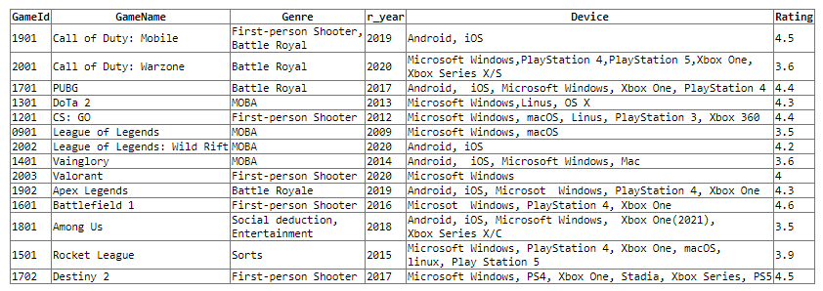

Slide 14
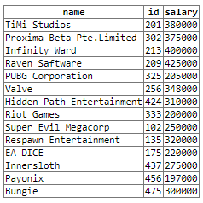
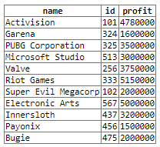

Slide 15
























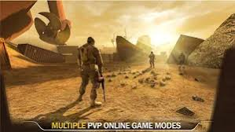


Slide 16
The End Thank You

